Slide 1
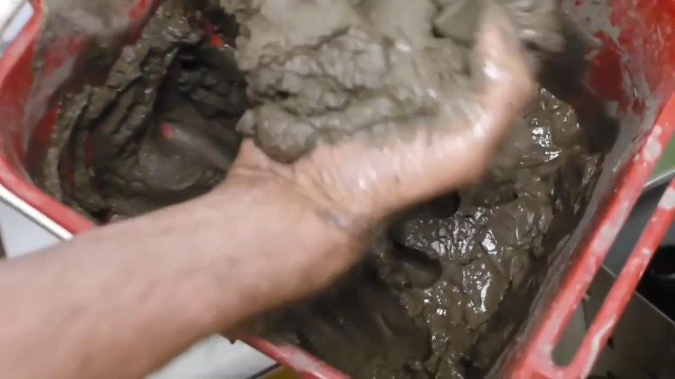
Richard LONG

Slide 2
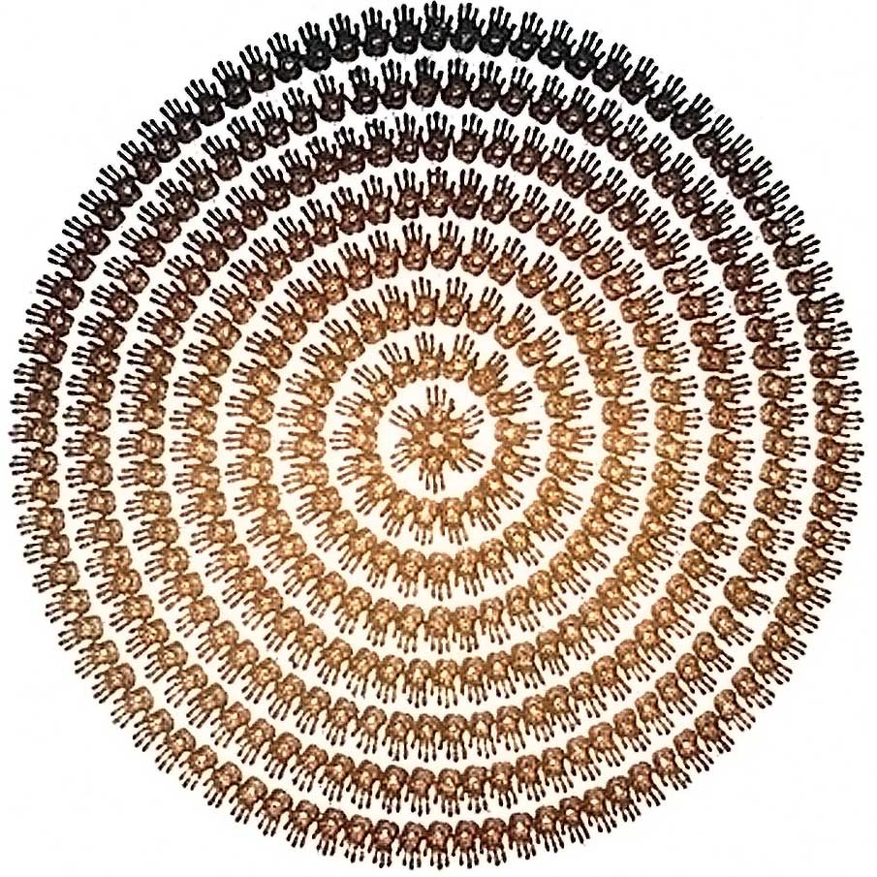
Richard LONG
Mud and circles - 1989

