Slide 1


Slide 2
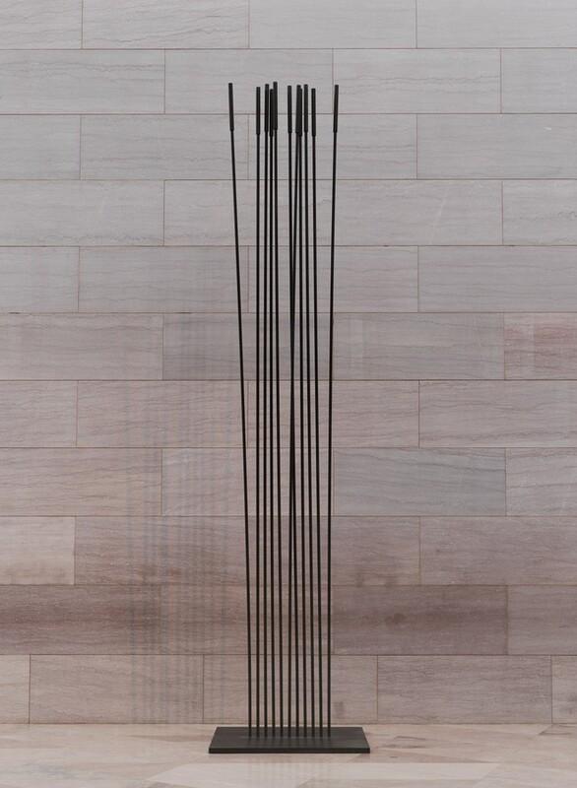
Harry Bertoia
Tonal Sculpture, 1977

Slide 3
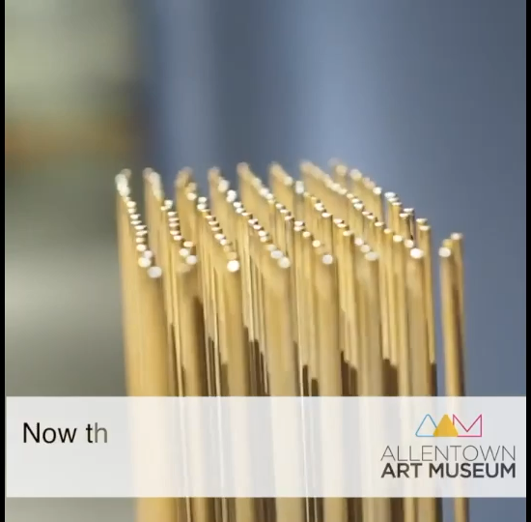

Slide 4
